Slide 1
Consciousness

Slide 2
Anesthesiology: alertness/responsiveness
Continuum – alert, oriented to time,place, communicative, delirium, loss of communication and finally a loss of movement to painful stimulation

Slide 3
Consciousness: awareness of ourselves and the environment
Dennet: color phi phenomenon
Awareness comprises the small fraction of those mental events whose influence will persist and alter beliefs about what just happened

Slide 4
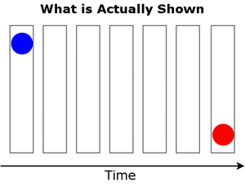

Slide 5
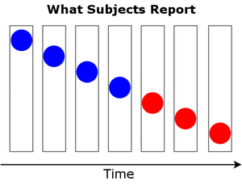

Slide 6
Hippocampal complex: short term episodic memory
recollection when cues stimulate memory – both recent and remote
familiar
Hippocampal damage – affects recall of recent information but not retrieval of remoter events.

Slide 7
Oliver Sacks “Greg” brain tumor
damaged area around the hippocampus and its adjacent cortex
Confined to a single moment
lacking connection and continuity in his inner life
Mind looses its coherence
Notes:
.

Slide 8
Visual Perception
Crick & Koch - Mammalian visual system
Infinite visual patterns can be recognized
Account for perceptual unity ?(pattern recog pathway from visual to memory)
Cat’s visual cortex – oscillations
neurons are firing in synchrony (shape, color, movement)
Thalamus – cortex – reverberatory circuit
for very short term memory

Slide 9
Dual Processing/The Two Track Mind
Goodale & Milner (2004, 2008)
‘Sight Unseen’
case of DF
Horizontal or vertical mail slot
Different parts of the brain control
- conscious perception/recognition of objects (ventral stream)
- reaching and grasping for objects
(dorsal stream)
Notes:
Dorsal stream – visually guided behaviour, motion, faster speed, lower consciousness, very short term memory
Ventral stream - recognition function, long term memory, slower speed, high consciousness

Slide 10
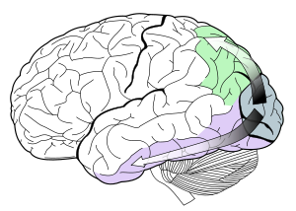
Notes:
Green – Dorsal Stream
Purple – Ventral Stream
Recent review 2010 G & M dorsal is semi-autonomous that operates under the executive that is informed by the ventral stream
‘There isn’t as much differentiation – between streams – to be thought of as heuristics – to guide work. We need to think of things in terms of dynamic novel functional networks – ‘ - McIntosh and Schenk

Slide 11
Libet (1985, 2004)
- consciously move your wrist
- experience the decision to move your wrist 0.2 seconds before the actual movement
- brain waves are 0.35 seconds ahead of the conscious perception of the decision

Slide 12
Wegner (2002)
Press a button when you feel a tap – respond in 1/10th of a second – less time than needed to become conscious that you have responded
Soon et al 2008
fMRI brain scans enabled researchers to predict (60%) up to 7 sec ahead participant’s decisions to press a button with their right or left finger

Slide 13
Chalmers (1995) - easy and hard problems of consciousness
Easy – integration of information, reportability of mental states, focus of attention………… (access consciousness)
Hard – problem of experience – subjective quality of redness, or the sound of the clarinet
(phenomenal consciousness)
Nonreductive explanation

